Slide 1

Market Basket Analysis Apriori Algorithm
S. Narayan Rao
Machine Learning Advanced - Assignment
November 2019 Cohort Batch, INSAID

Slide 2
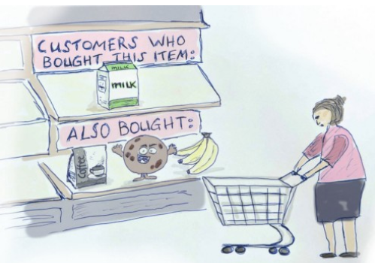
Content - Market Basket Analysis
Introduction
Objective of the analysis
Importing Python Libraries
Importing Data and Processing
Exploratory Data Analysis
Applying Apriori Algorithm & Result
Conclusion

Slide 3
Introduction
Market Basket Analysis is one of the key techniques used by large retailers to uncover associations between items. It works by looking for combinations of items that occur together frequently in transactions. To put it another way, it allows retailers to identify relationships between the items that people buy.
Objective :
To improve the effectiveness of marketing and sales tactics using the customer data that is accumulated with the enterprise during the sales transaction.

Slide 4
Importing Python Libraries
Market basket analysis done in Python Program,
following libraries used :-
NumPy
Pandas
Matplotlib
Seaborn
Apriori (Mlxtend)
Association Rules

Slide 5
Importing Data & Processing
Grocery Sales Data used for the market basket analysis
https://github.com/insaid2018/Term-4/blob/master/Projects/groceries.csv
Total 9834 records and 32 columns found in the data
Delete NaN Items from dataset
Transform every transaction to separate list
Final Step: Make a new appropriate Pandas data frame for visualizations
Convert dataset into 1-0 encoding - applying Apriori Algorithm

Slide 6
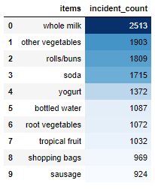
Exploratory Data Analysis
From the top 10 list we found - Whole Milk, Other Vegetables, Rolls/Buns, Soda & Yogurt are top 5 product are the most demanded items.

Slide 7
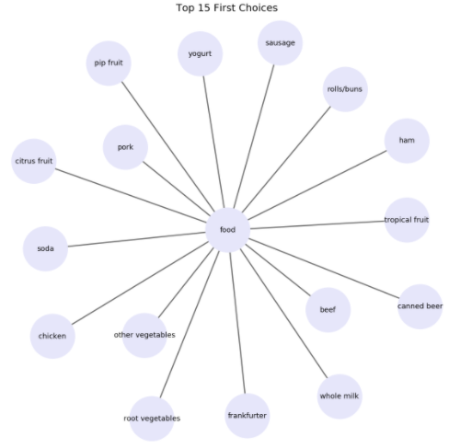
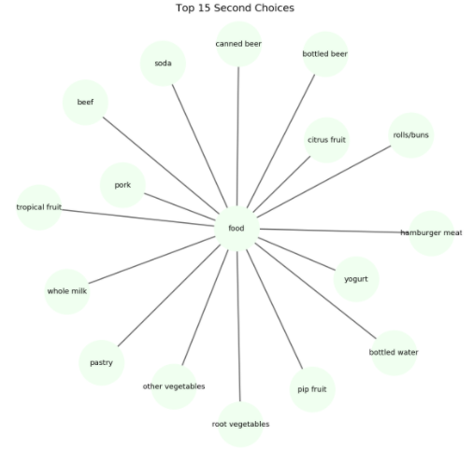
Exploratory Data Analysis

Slide 8
Applying Apriori Algorithm & Result
Apriori algorithm uses "bottom up" approach, first identify individual items that satisfy a minimum occurrence threshold. It then extends the item set, adding one item at a time and checking if the resulting item set still satisfies the specified threshold. The algorithm stops when there are no more items to add that meet the minimum occurrence requirement.
Support is an indication of how frequently the items appear in the data.
Confidence is the conditional probability of occurrence of consequent given the antecedent.
Lift can be used to compare confidence with expected confidence. This says how likely item Y is purchased when item X is purchased.

Slide 9
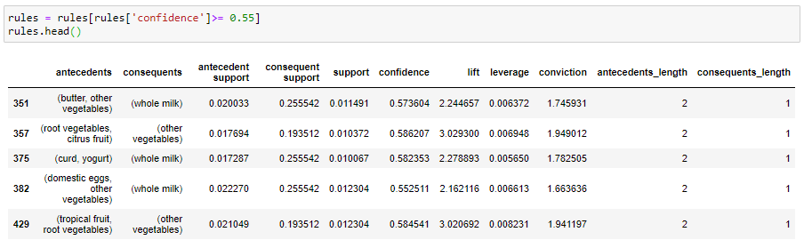
Applying Apriori Algorithm & Result
Interpretation :
Support value for green highlighted products is 0.01. (how frequently the items purchased by customers)
Confidence value is 0.58, which shows that out of all the transactions that contain Curd & Yogurt, 58.23% of the transactions also contain Whole Milk.
Lift value is 2.28, tells us that Whole Milk is 2.28 times more likely to be bought by the customers who buy Curd & Yogurt.

Slide 10
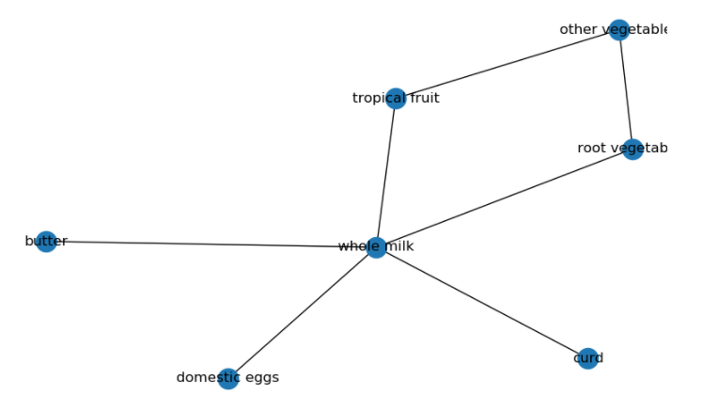
Conclusion :
Whole Milk is the best seller (high demand) and it shows association with 6 items- Butter, Curd, Domestic Eggs, Tropical Fruit, Root Vegetable and Other Vegetables. There are a couple of strategies that the store can adopt to increase its sales considering the association we have seen between Whole Milk and its 6 partners.
product bundling can be done with discounts / loyalty schemes / incentives etc to increase the business.

Slide 11
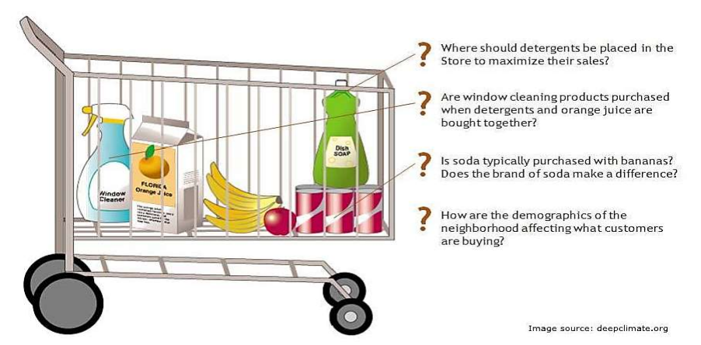
Thank you !

